Slide 1
Texas Tech University Health Sciences Center
Purchasing quarterly meeting
Ttuhsc pURCHASING

Slide 2
Purchasing will be conducting Quarterly meetings to provide:
New information
System updates
Announcements
Answer questions

Slide 3
Agenda
Techbuy Reminders
Purchase Category Selection
Required Attachments
W-9’s added by comments
Punch-out vendors
TeamApp
How to identify who the fund manager is
PO/Encumbrance Change request
Closing orders
Request for signature process
Bid Limits and contracting process
Questions and Answer period

Slide 4
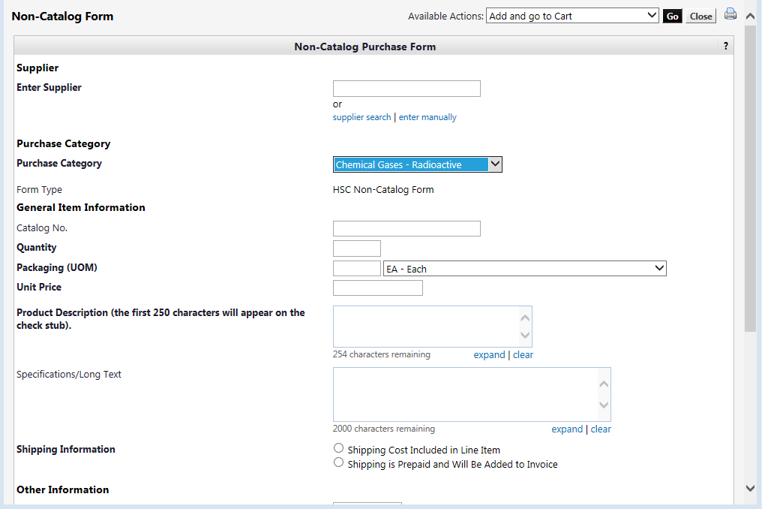
Purchase Category Selection
Select the purchase category that is correctly related to the items you are purchasing. The purchase category allows the order to route to the correct departments and purchaser for approval.

Slide 5
Required Attachments
Valid quote
W-9 if vendor has not been established
Pre-approval form if an event PO
ICQ if individual performing services
Insurance certificate if vendor will be on premises
Agreement if required by vendor
W-9’s
Please attach to internal attachments if W-9 is received prior to requisition. Purchasing will work with the vendor team to establish the vendor.
Please do not attach W-9 using the comment feature after the requisition has been processed. This prevents us from having the ability to remove the document.

Slide 6
Punch-out Vendors
Please do not accept substitutions when using a punch-out vendor. Purchasing is unable to modify punch-out orders in TechBuy. If the item is not available, please cancel the item on the current order using the PO/Encumbrance change request. Next, create a new punch-out order requesting the replacement item.

Slide 7
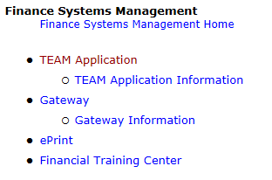
TeamApp
It is recommended to have 2 approvers for each fund for backup purposes.
How to identify who the fund manager is
How to identify if a user is on a specific fund
Enter TeamApp through Webraider under the F&A Work Tools tab. Click on Team Application.
Team Application

Slide 8
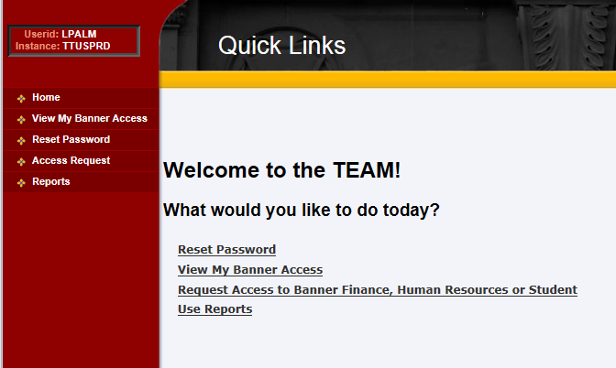
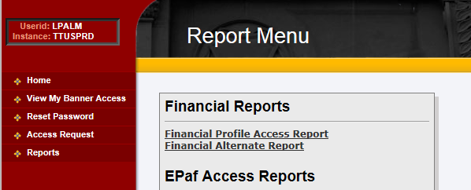
Next, click Reports and Financial Profile Access Report.
Reports
Financial Profile Access Report

Slide 9
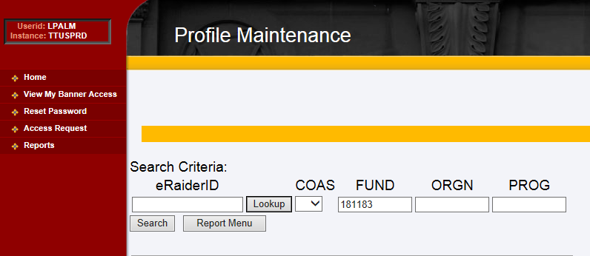
Enter fund number in the fund field. Click Search.
Enter Fund Number
Search

Slide 10
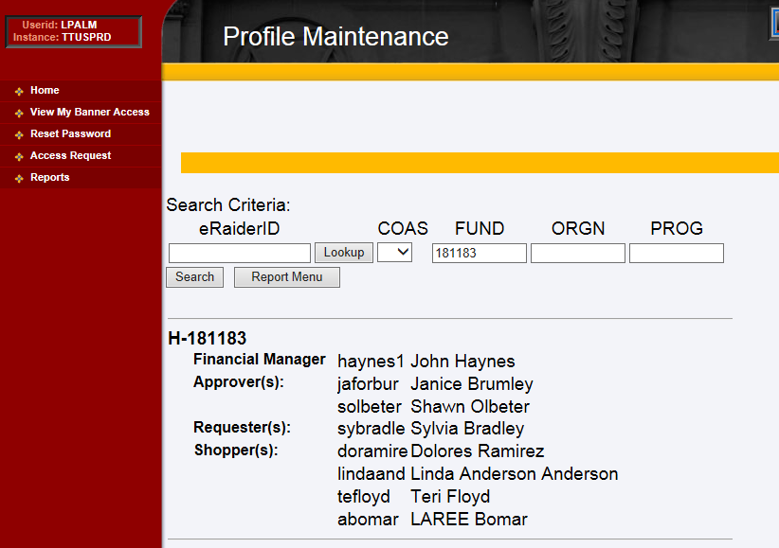
The search results will display the fund manager(s), approver(s), requester(s), and shopper(s).

Slide 11
Closing Orders
FY15 is half way complete. Please monitor your encumbrances and close orders when the order is complete/paid.
Orders are not complete until the invoices are paid. Please do not close orders if the items have just been received and have not been paid. If the order is closed Accounts Payable cannot pay the invoices.

Slide 12
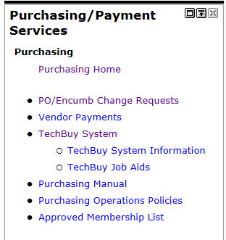
To access the PO/Encumbrance change request system go to the F&A Work Tools tab in WebRaider. In the Purchasing/Payment Services section click on PO/Encumbrance Change Requests to enter the system.
PO/Encumbrance Change Requests

Slide 13
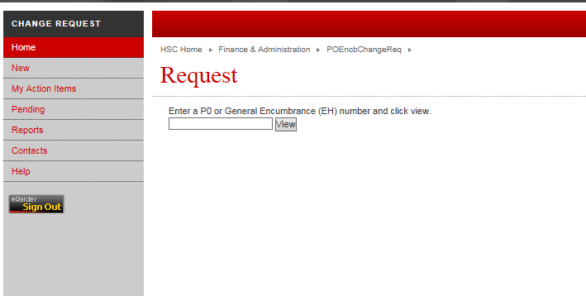
To enter a new change request click New. Next, enter the PO# in the PO field and click View.
New
Enter PO# and click View

Slide 14
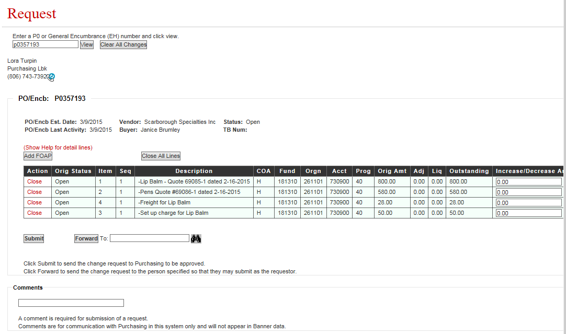
To close a single line item click Close in the action column of the item you would like to close.
Click Close

Slide 15
To close full order click Close All Lines. This will close the full order and does not require negative amounts to be entered in the amount column(s).
Click Close
All Lines

Slide 16
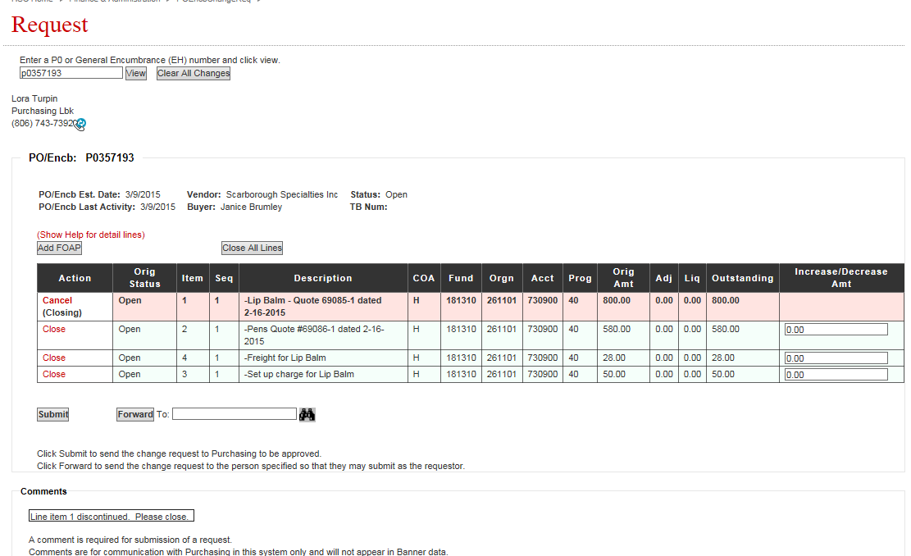
Once all line items are selected to be closed. Enter a comment explaining why the lines are to be closed and click Submit.
Submit
Enter Comment

Slide 17
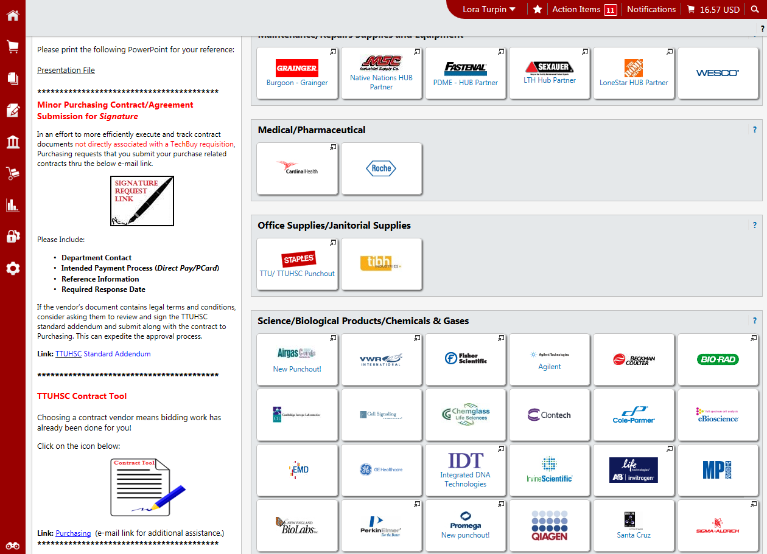
Signature Request Link
Submit contract documents that are not directly associated with a TechBuy requisition through the link on TechBuy home/shop page.
Signature Request Link
Addendum Link

Slide 18
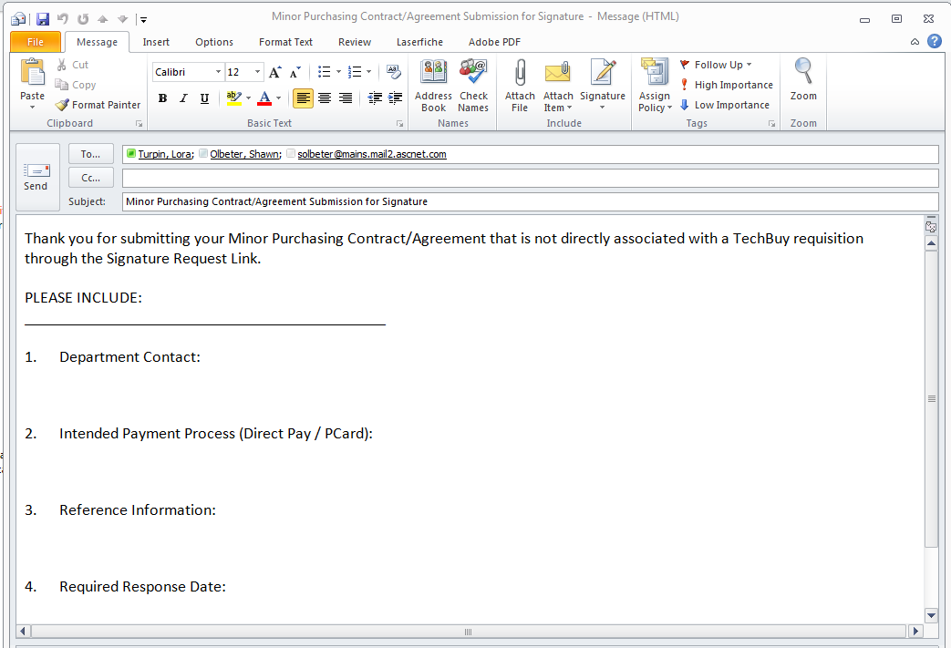
The signature request link will pull up a email box. Please complete requested information (items 1- 4) and attach document to be signed to the email.

Slide 19
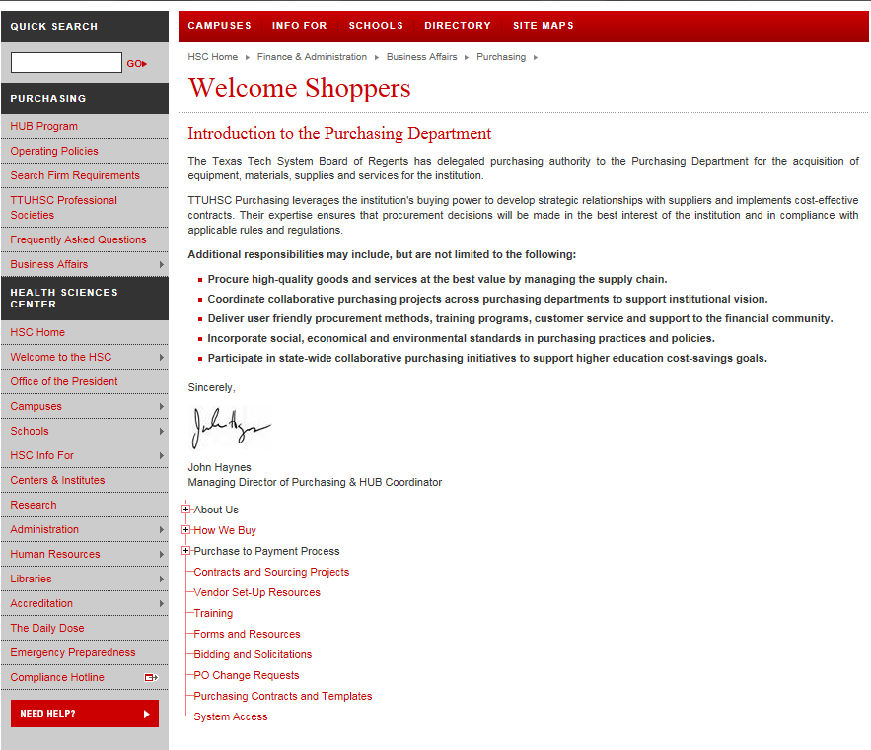
Bid Limits
The bid limits table is located on the Purchasing website in the TTUHSC Shoppers site. Click Bidding and Solicitations.
Bidding and Solicitations

Slide 20
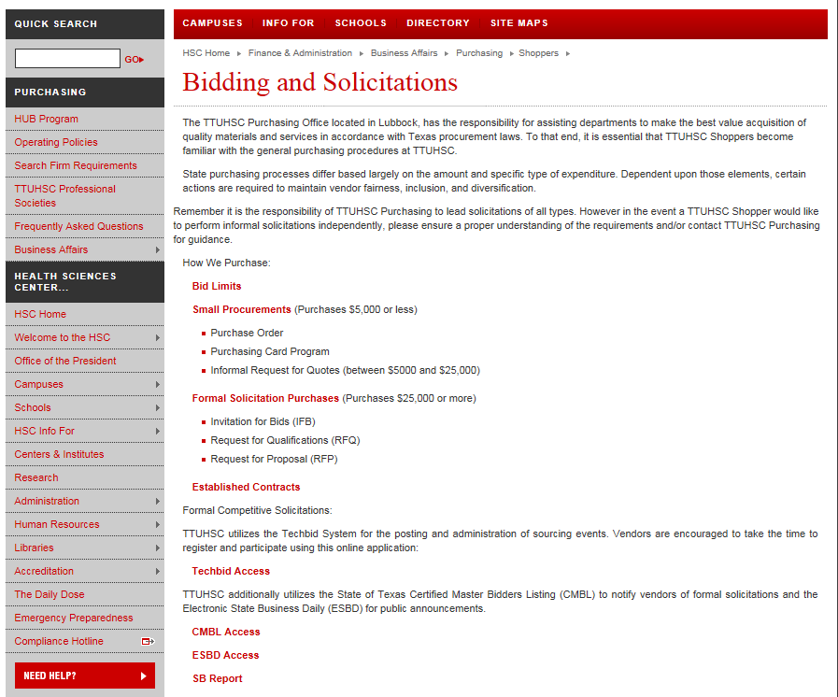
In the Bidding and Solicitations click Bid Limits to pull up the bid limits table.
Bid Limits

Slide 21
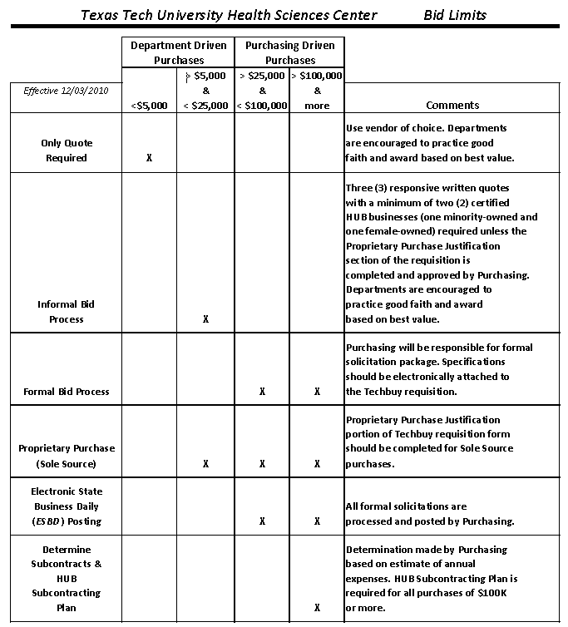

Slide 22
Contract Process
There are several ways to access established contracts in TechBuy. First, is from the Bidding and Solicitation sites. Click on Established Contracts.
Established Contracts

Slide 23
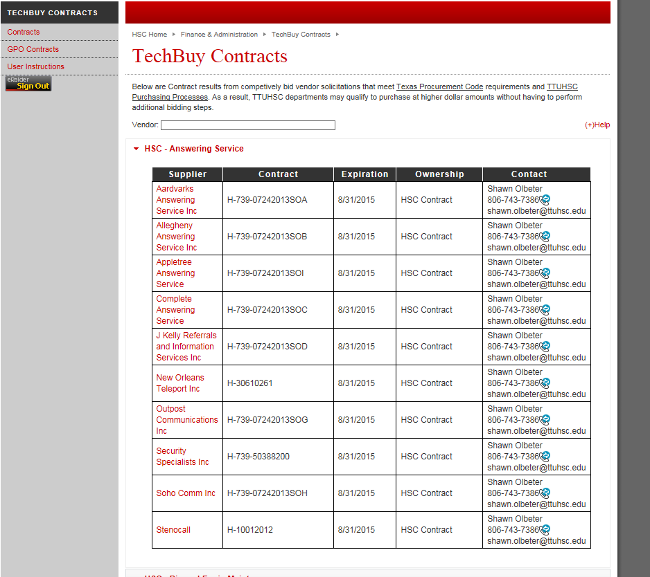
The established contract link will take you to the TechBuy Contracts. There is a search by vendor name or by category. As seen below, these are vendors available on contract for Answering Services.
Vendor Name
Category

Slide 24
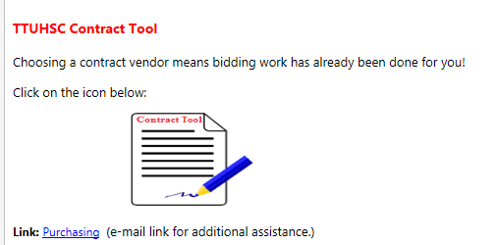
The second option to enter the established contracts is through the TTUHSC Contract Tool located in the announcements in TechBuy.
Click Contract Tool Icon
For additional assistance

Slide 25
Questions ?

